Slide 1

Financial Status Report MVP
Usability Readout
Riley Orr & Rebecca Walsh
UX Designers
April 6, 2021

Slide 2
Veterans’ experience with the form

Slide 3
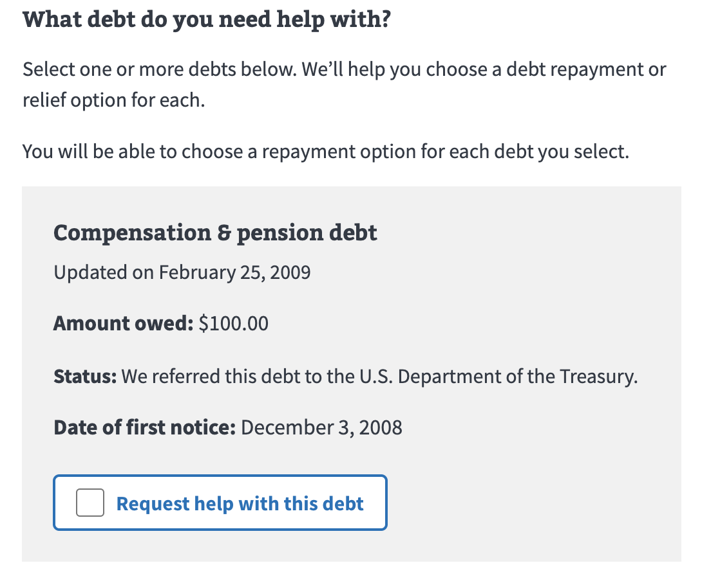
FSR MVP Usability
Interpreting and selecting debts
Multiple participants initially selected the first card for ‘compensation + pension’ debt
This could be because they didn’t understand that the scenario was for post-9/11 GI Bill debts or they assumed they would want assistance for all available debts
Multiple people were confused by the Post-9/11 GI Bill debts being split, while others preferred it

Slide 4
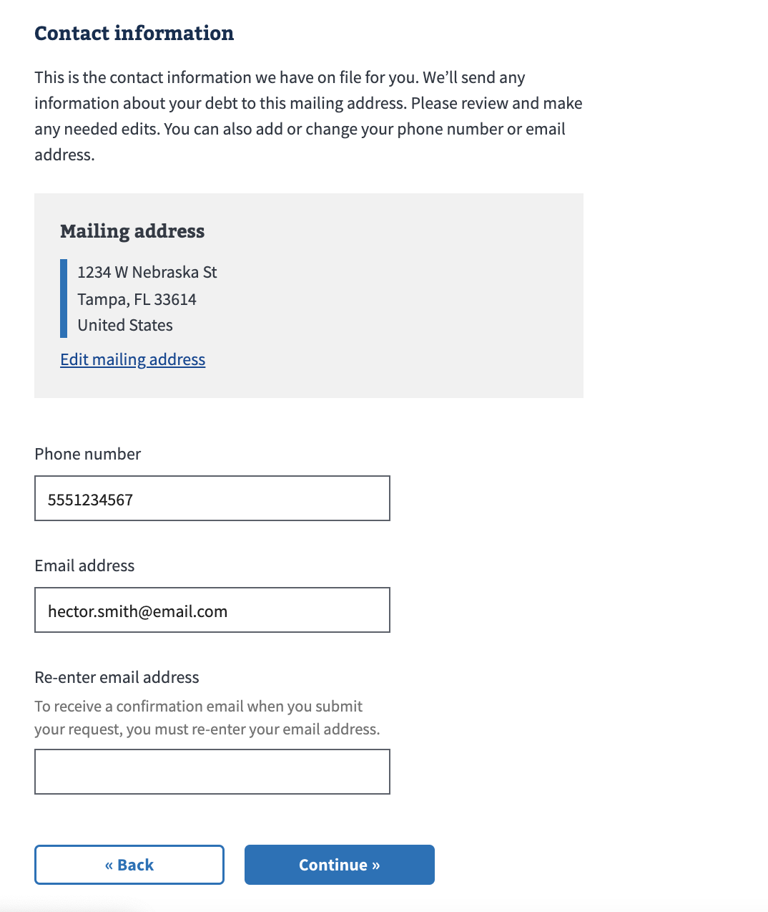
FSR MVP Usability
Providing personal information
Every participant re-entered their email address
1 participant didn’t like having to re-enter the email address since it was already being pulled in from his profile
Participants expected email correspondence including updates about their debt, form submission confirmation, and processing information

Slide 5
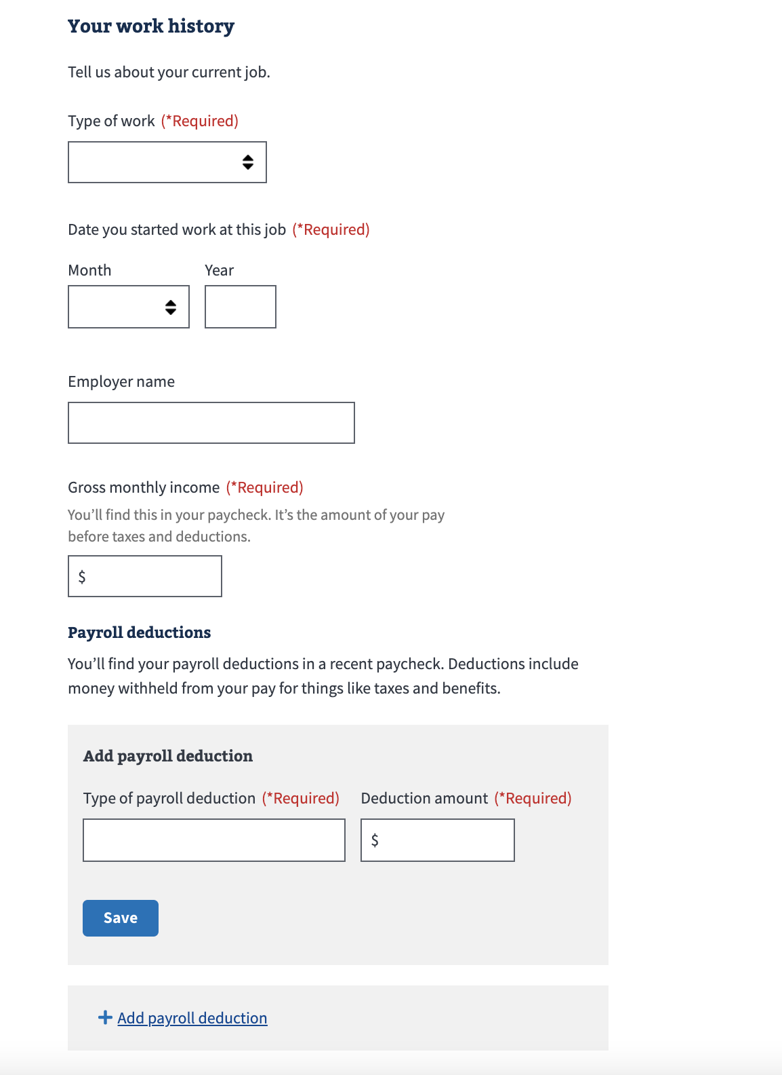
FSR MVP Usability
Providing work history
Some participants had varying income per check due to contractual work
Many struggled to include their payroll deductions
Many were unsure what to include
One thought they could only include one payroll deduction
One stated they have contractual work and didn’t have any payroll deductions
Some had more than one current job

Slide 6
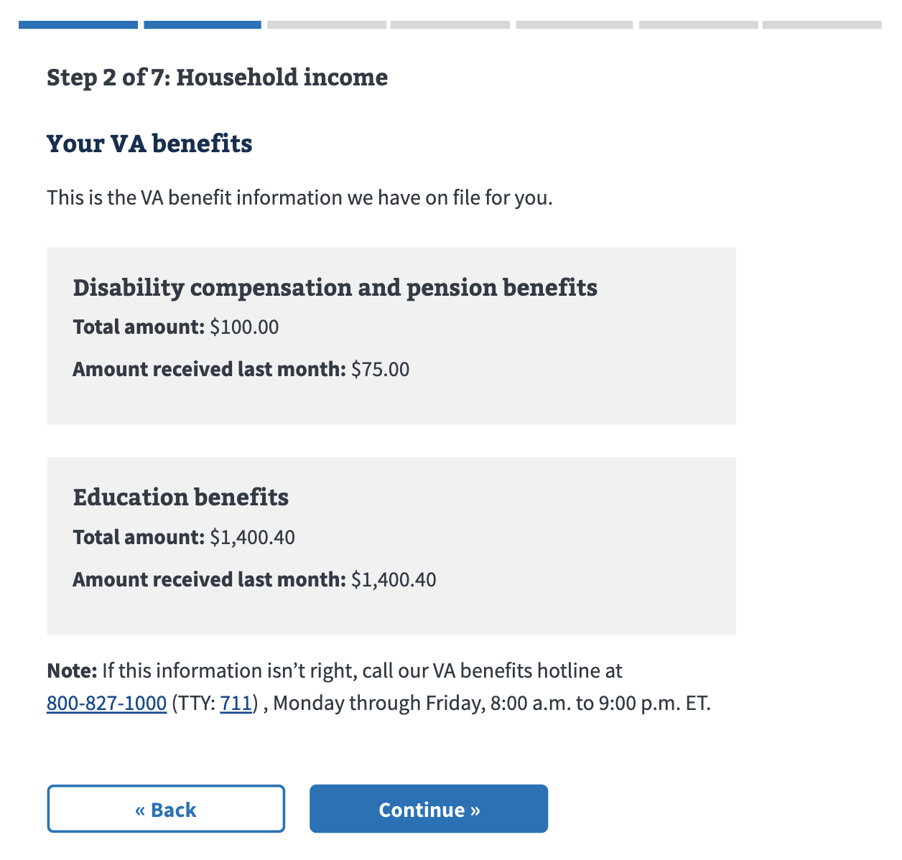
FSR MVP Usability
VA benefits
Some participants agreed that VA benefit payments should be included in income, while others thought it would be excluded
Some participants were able to explain why the total amount was different from the amount received, but others were angry that it didn’t state the reason

Slide 7
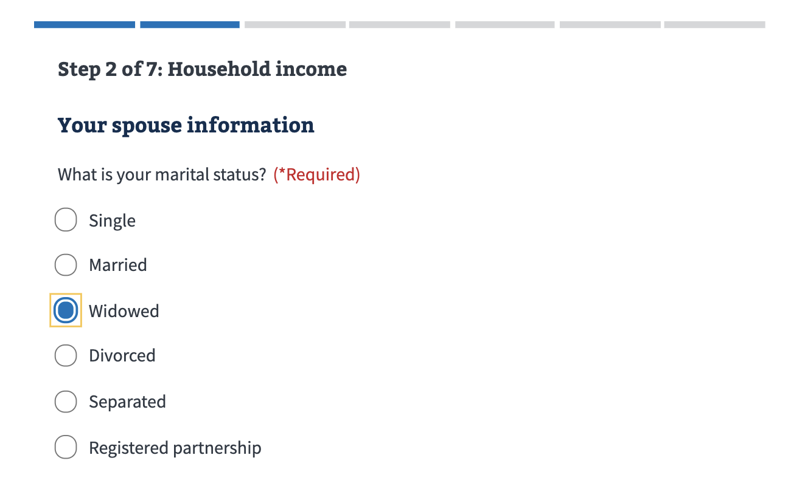
FSR MVP Usability
Spouse information
One participant was very bothered by the designations of marital status
"It’s insulting, because I am divorced, and it doesn’t matter. Unless you guys can come up with a legal reason, there’s no reason for it. It’s prejudicial."
Several participants weren’t sure why their spouse’s information would be relevant to their benefit debts
Several participants would need their spouse’s help to fill in their employment details

Slide 8
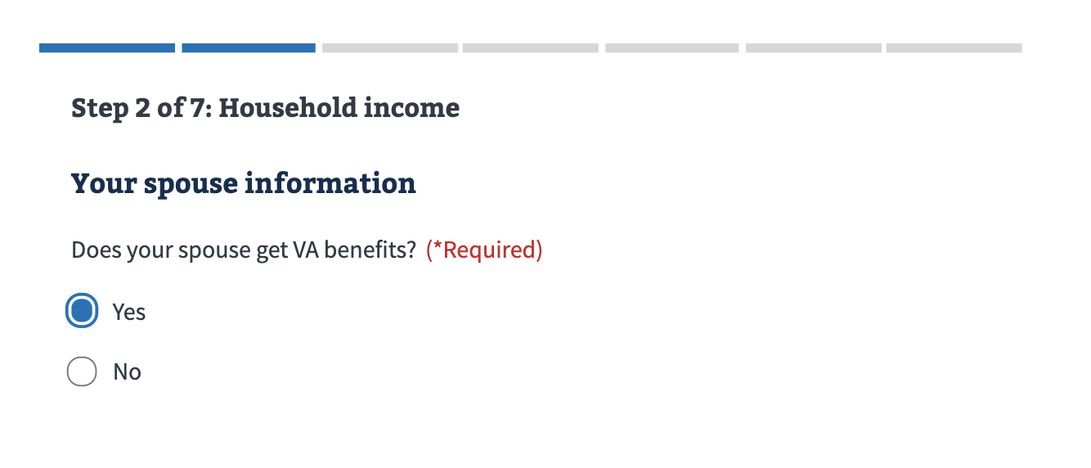
FSR MVP Usability
Spouse information
One participant hesitated and wondered qualified as “VA benefits”
“My husband has Tricare, does that count?”

Slide 9
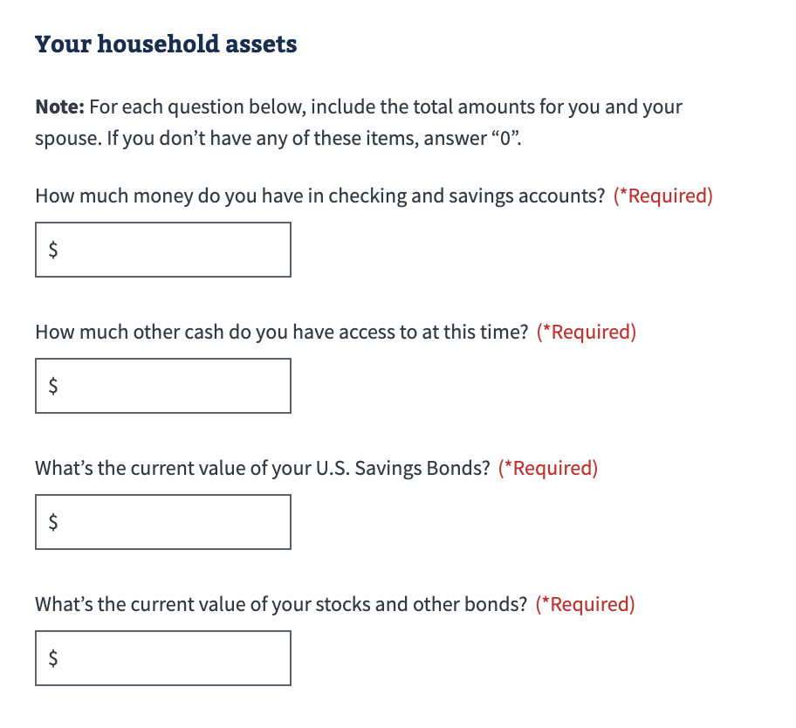
FSR MVP Usability
Household assets
Several participants reacted negatively to this section
One participant remarked, “if I had U.S. Savings Bonds or stocks, I wouldn’t be filling this out!”
Some of our participants would omit their other cash

Slide 10
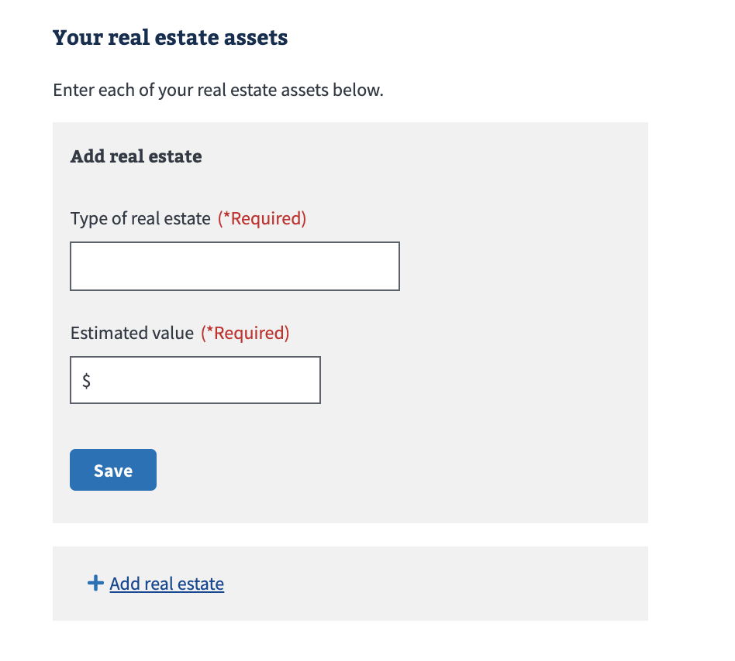
FSR MVP Usability
Real estate assets
One participant commented that he didn’t own the house, the bank did
Most people knew the approximate value of their home off the top of their head and would not look it up

Slide 11
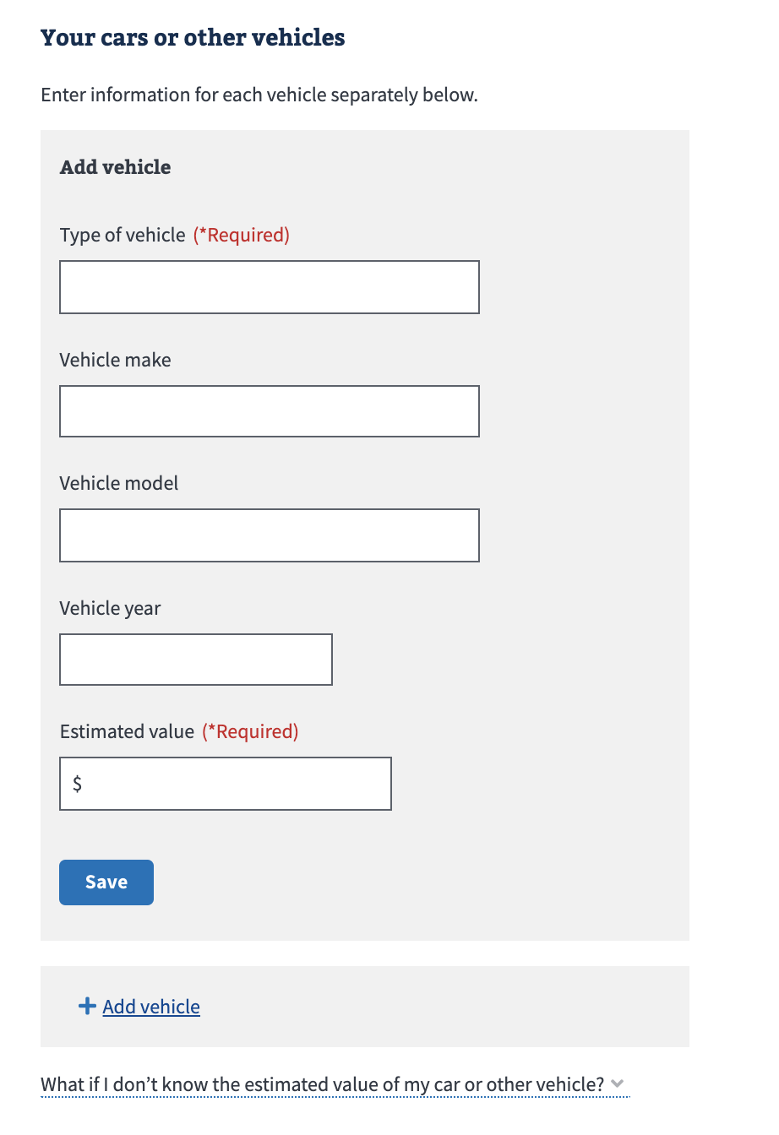
FSR MVP Usability
Vehicles
Most participants were unhappy about needing to provide information about their vehicle, due to the level of detail or fear
Many participants felt that VA would repossess their vehicle or deny assistance if they provide information about their cars
One participant didn’t know the make and model of his vehicle
One participant wondered about leased vehicles

Slide 12
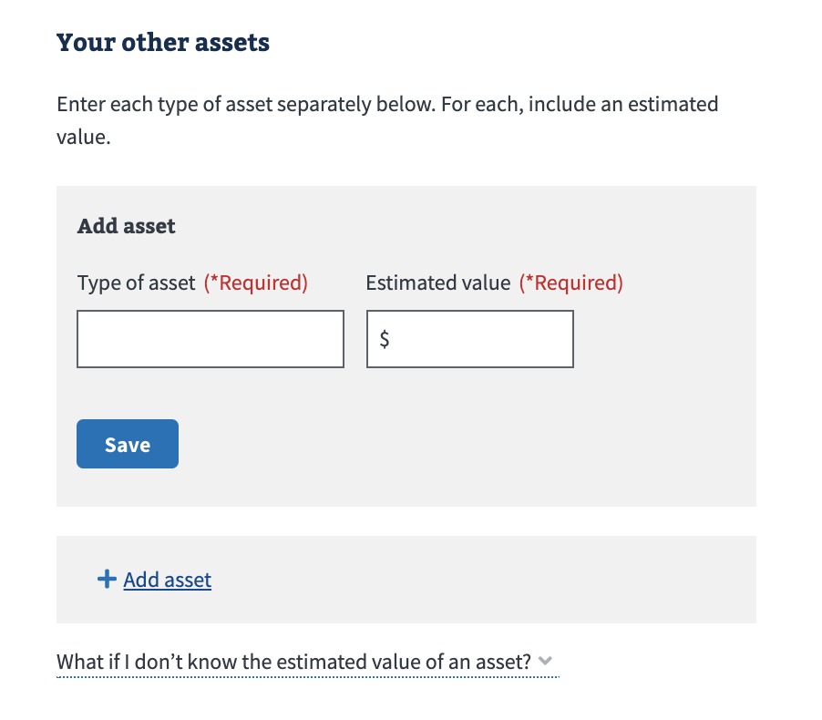
FSR MVP Usability
‘Other’ household assets
Most participants said that they did not have any additional assets
Some participants raised some concerns about if their family heirlooms or sentimental items would be on the line
Some participants stated that they would omit their other assets because “it’s none of their business.”
A couple participants weren’t sure what value qualified as an asset

Slide 13
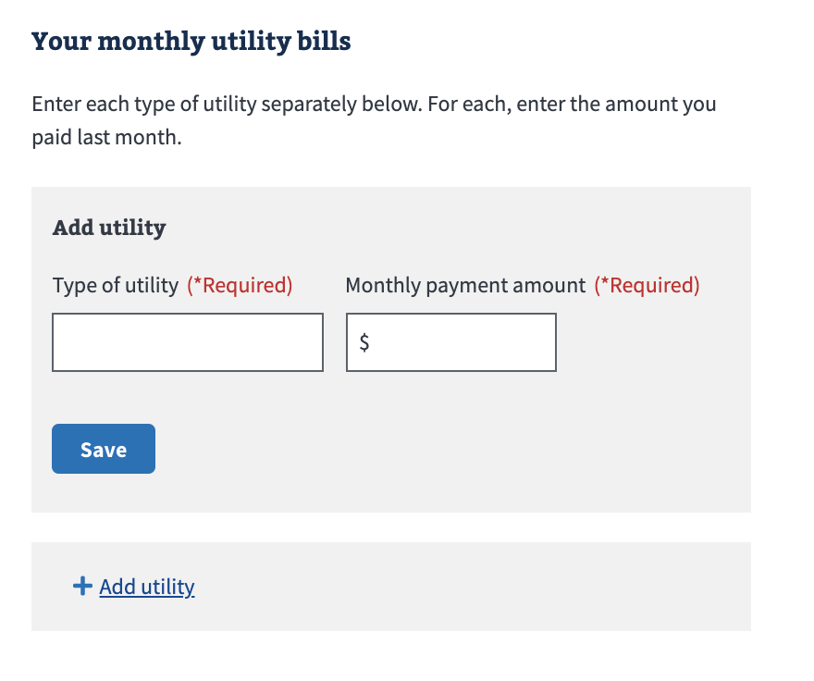
FSR MVP Usability
Utilities
Some participants noted that they’d prefer to provide combined utilities
One participant wondered if things like internet and cell phone bills qualified
One participant noted that they pay certain bills quarterly
One participant noted that some of their utilities are combined (e.g. water + sewer + trash)

Slide 14
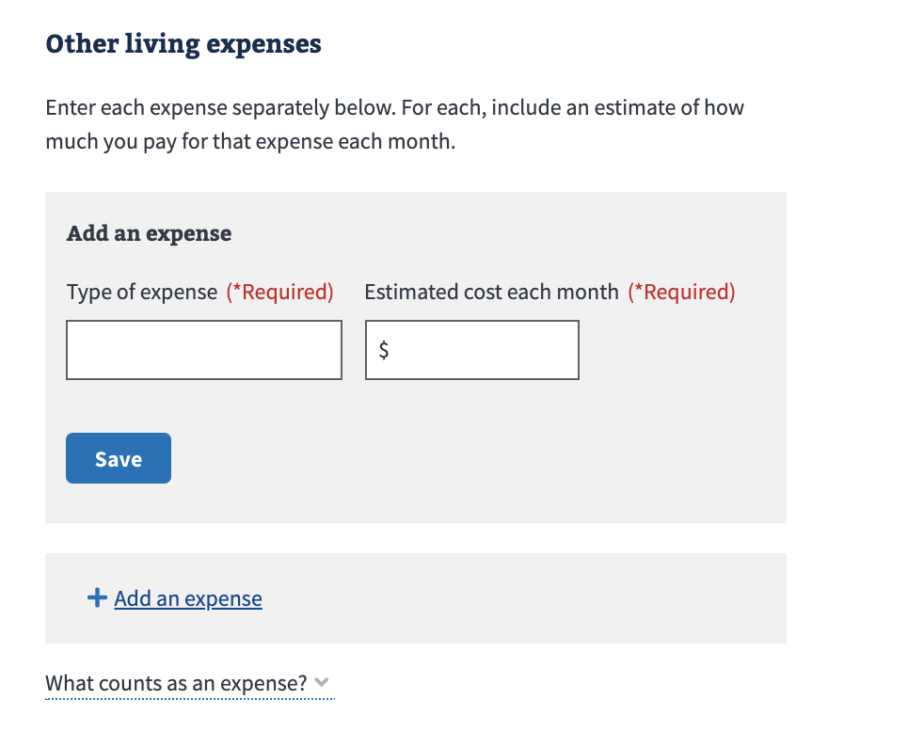
FSR MVP Usability
Other living expenses
Many participants seemed to struggle to recall relevant expenses to include in this section
One participant felt strongly that adding other living expenses would count against her, while most were generally aware that providing expenses would benefit them

Slide 15
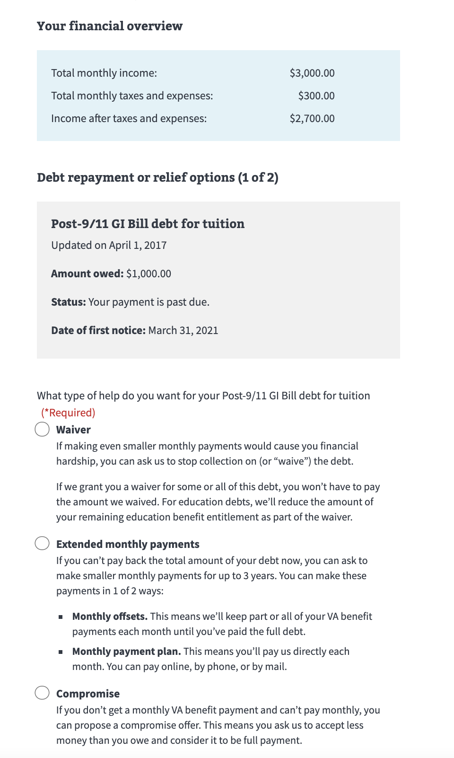
FSR MVP Usability
Debt repayment or relief options
Some participants noticed the ‘1 of 3’ and understood its purpose, while others thought they were being forced to select a different relief option because they did something wrong
3 participants mentioned wanting to be able to select multiple resolution types as backups
Most participants understood resolution types available
Some participants wanted to see more detail in the ‘financial overview’ section, such as an expanded breakdown of the values

Slide 16
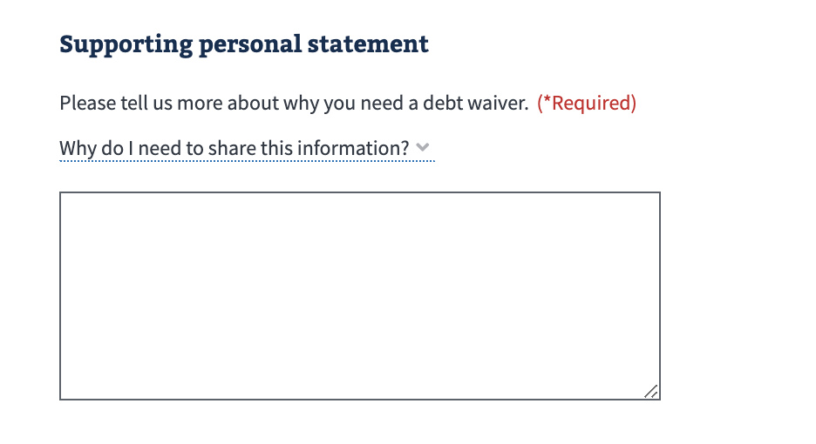
FSR MVP Usability
Supporting personal statement
Everyone understood the personal statement’s goal
The length people would write varied
Most people said they would write 1-2 paragraphs or 1-2 sentences
“I don’t have the financial means to pay this and continue to afford to live”, “We don’t see a light at the end of the tunnel right now”, “Because I have negative income”

Slide 17
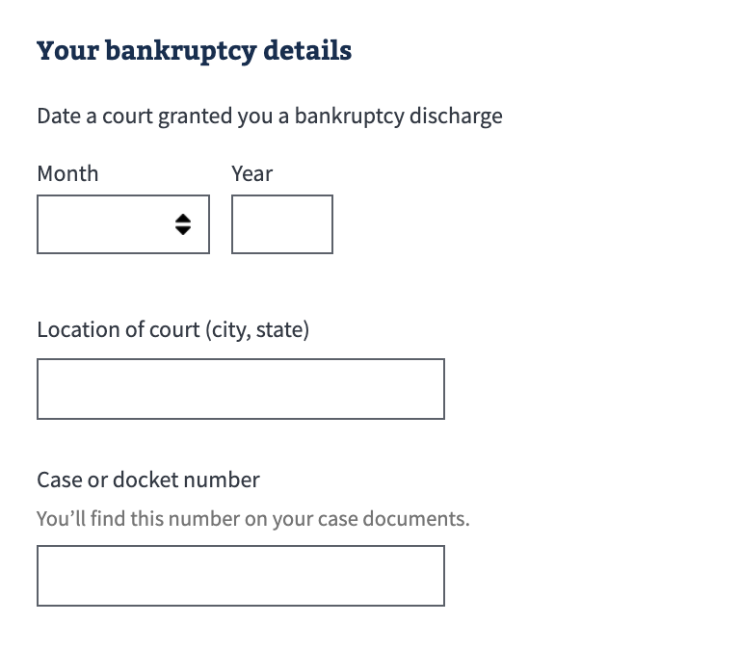
FSR MVP Usability
Bankruptcy details
4/10 participants said they had declared bankruptcy in the past
Two didn’t think it was recent enough to be considered
One didn’t believe bankruptcy was relevant
One considered bankruptcy within 2 years to be pertinent while another considered 10 years to be pertinent

Slide 18
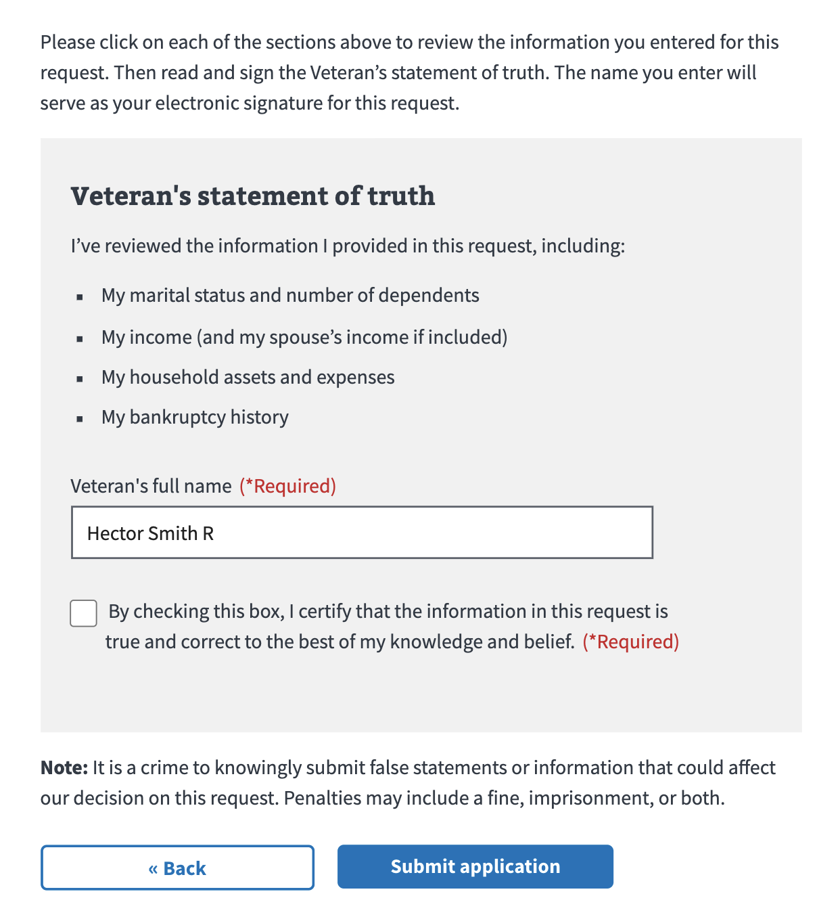
FSR MVP Usability
Review & Submit
One participant was sensitive to the wording of the ‘Note:’ before submitting the form. He’d have to retroactively make sure all of his numbers are accurate

Slide 19
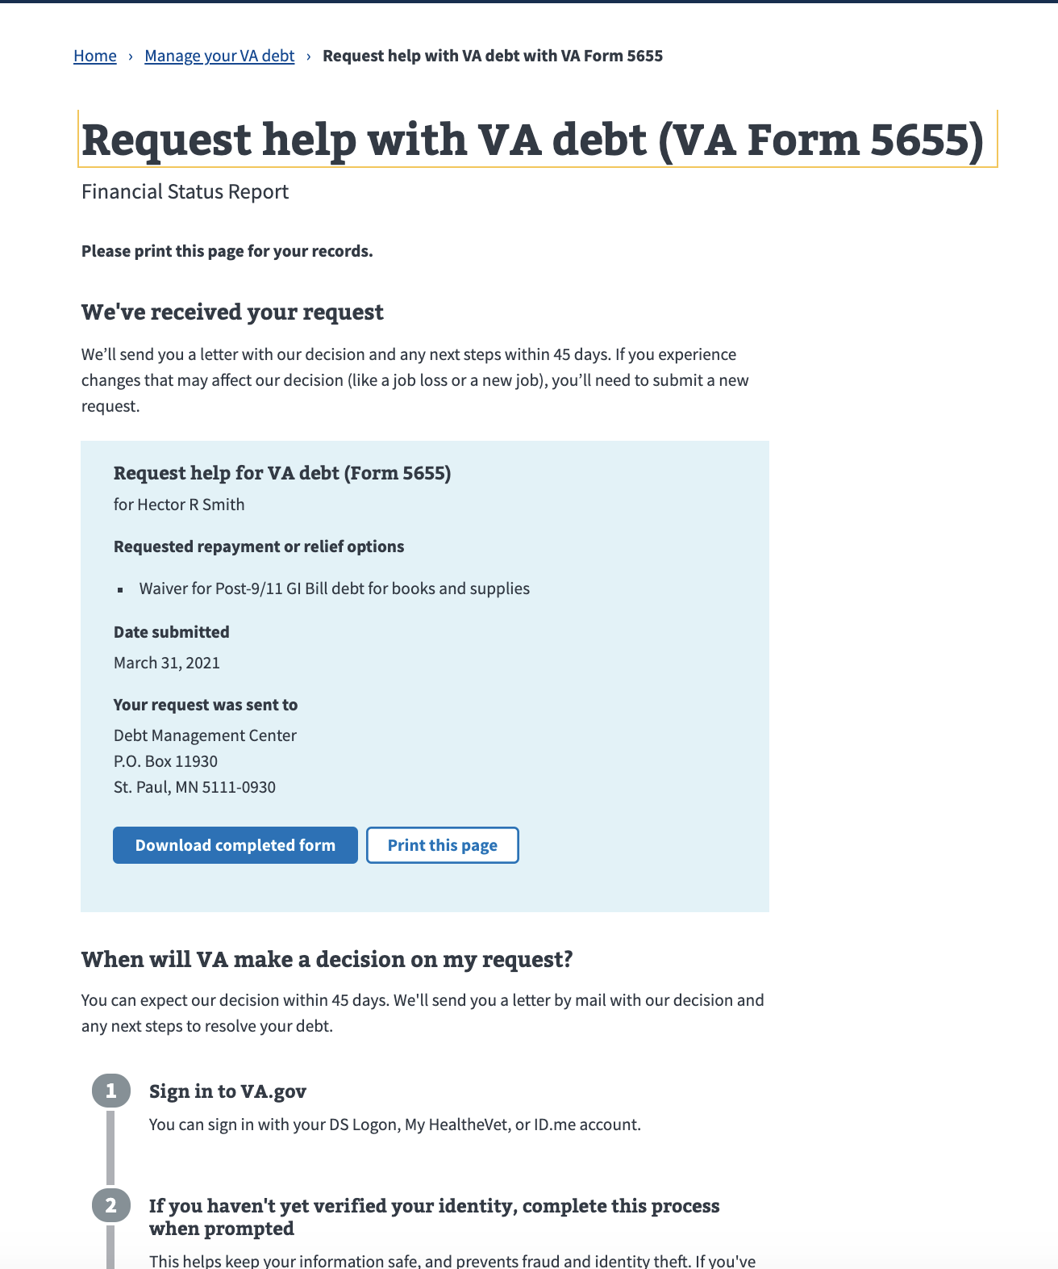
FSR MVP Usability
Confirmation page
Veterans expected to see their submission confirmation both as a page and a followup email
Veterans expected that confirmation to include a reference number and timeline
Multiple Veterans wanted to keep a copy of their submission for their records as “proof”
Notes:
A majority of Veterans expect a confirmation or notification as well as
5 expected a followup timeline, with 1 specifying that they expected a followup phone number that they would call after the followup date passed
4 would check their email for a notification
3 expected an application/reference number
Multiple Veterans expected to obtain a copy of the submission
3 wanted to download the full document
1 would take screenshots of all entries as proof
2 would keep a hard copy in case VA lost their submission
"Pray", "go drink a beer", "go lay down", "Congratulations, you lived!"

Slide 20
Answers to our research questions

Slide 21
FSR MVP Usability
Do Veterans understand the available repayment options?
Generally yes, aside from a few misinterpretations. Of ten participants:
Three participants were under the impression that their entire monthly entitlement would be reduced until the full debt was repaid
Two participants didn’t understand the difference between monthly offsets and monthly payments
One participant interpreted ‘Compromise offer’ to mean forbearance / pay it later

Slide 22
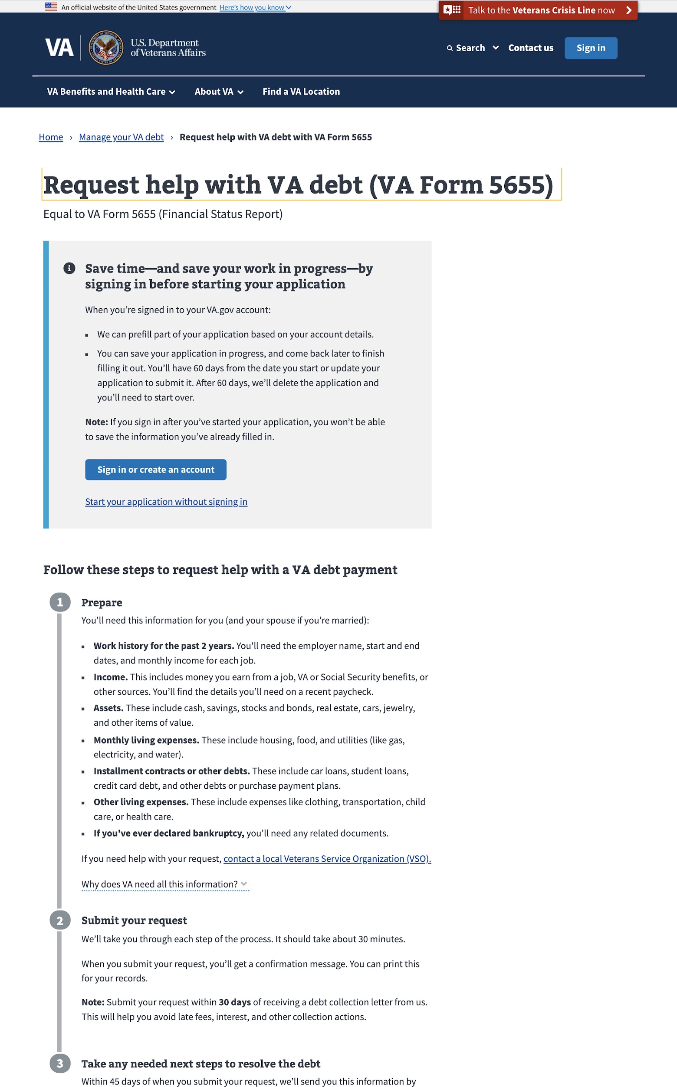
FSR MVP Usability
Do Veterans read the subway map steps?
Sometimes;
Most participants’ first instincts were to sign in upon seeing the alert
Some didn't notice the content below the sign in alert initially, but thought that content was important and would read it before proceeding
"I probably wouldn't have seen the explanatory steps below. I think I should see that first."
“Oh! That’s educational.”

Slide 23
FSR MVP Usability
Do Veterans read the subway map steps?
Sometimes;
A couple participants stated they would read through the subway map before signing in
One participant said that they would not begin the form until she had all of the information in the subway map available

Slide 24
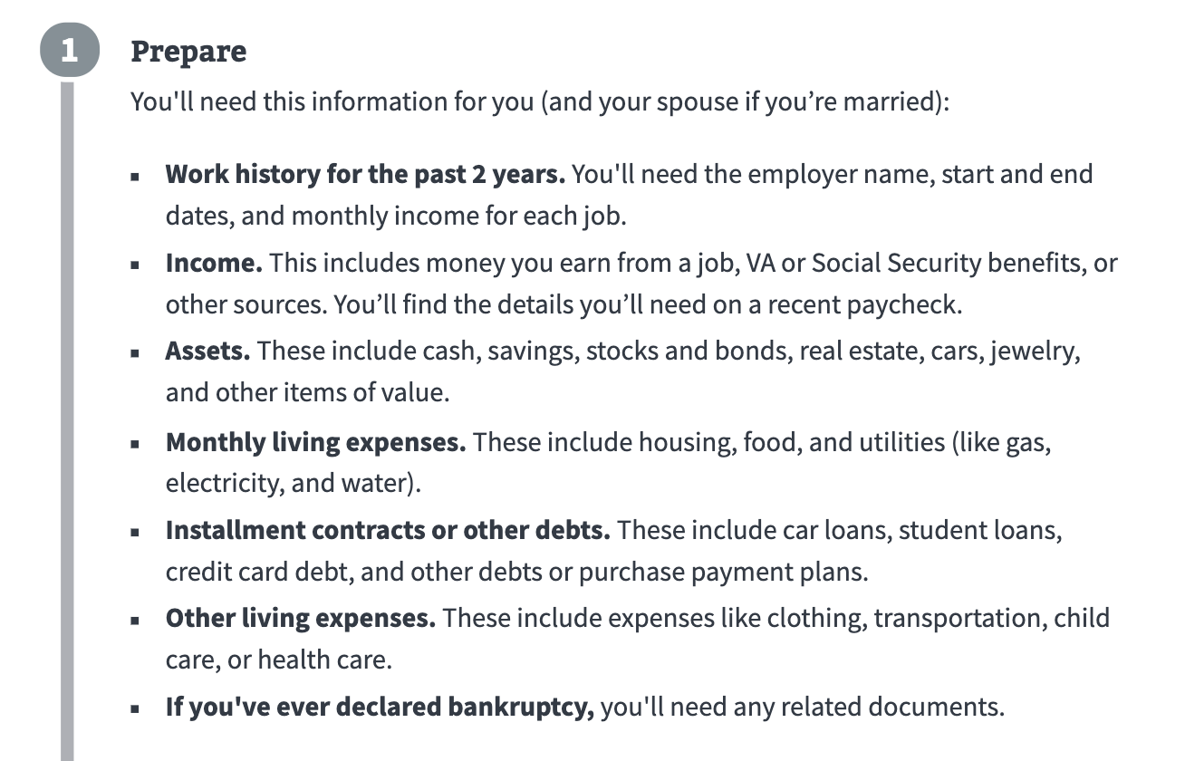
FSR MVP Usability
What do they think about providing their financial details?
Split reactions;
Some participants said that the information requested was standard and expected
Some participants were very concerned about the amount of information needed, especially assets
“Ohh boy.”

Slide 25
FSR MVP Usability
What do they think about providing their financial details?
Split reactions;
“I’m just a veteran on SS… I’m 74 years old, I don’t have child care, clothing, and transportation… so I guess I’d have to muddle through all of this. Stocks, bonds, and real estate, if I had all of that, I wouldn’t be asking for help. I can understand where they’re coming from… and it’s just um… something I don’t care to do. I’d rather just pay. It just seems overwhelming.”

Slide 26
FSR MVP Usability
Would Veterans be able to easily provide their spouse's employment and income information?
Sometimes;
Most participants stated that they would know their spouse’s employment details, but would estimate or ask for assistance for income information
Participants’ comfort level varied around providing their spouse’s information
Some were open to including it and understood why it was necessary, but others felt uncomfortable and unsure about why that information was required
One participant said they understood debts are “married”, but thought education debts should be an exception

Slide 27
FSR MVP Usability
Is it clear to Veterans why they need to provide their financial information?
Generally yes, but they still really don’t like it.
Most participants were able to identify why they’d be asked for their financial information for the sake of requesting financial assistance, but most felt like the form asked for too much detail
“I am becoming aware of the fact that the VA is no different than going to a bank - it’s a little intimidating to me that the VA would be asking me all of these questions as a senior citizen.”
“If this is what I have to do, I prefer not to. I could answer all these questions but I don’t see the relevancy. It’s not like I’m asking for a car loan.”

Slide 28
FSR MVP Usability
Is it clear to Veterans why they need to provide their financial information?
Generally yes, but they still really don’t like it.
Most participants could articulate how providing their income and expenses would affect their outcome, however a few participants believed that providing expenses could count against them
Several participants were extremely uncomfortable providing information about assets, believing that VA would repossess, put liens against, or ask them to sell their cars and other assets

Slide 29
FSR MVP Usability
Is it clear to Veterans why they need to provide their financial information?
Generally yes, but they still really don’t like it.
A few participants noted that they would be wary of providing information about family heirlooms or items they’ve owned for a long time
When it comes to providing values, several participants said they would omit or otherwise devalue their assets for a more favorable outcome or to preserve their privacy
"If I were doing it for real, I don’t think I would include my other assets. It’s not anybody’s business, and I don’t want anyone repossessing my jewelry.”

Slide 30
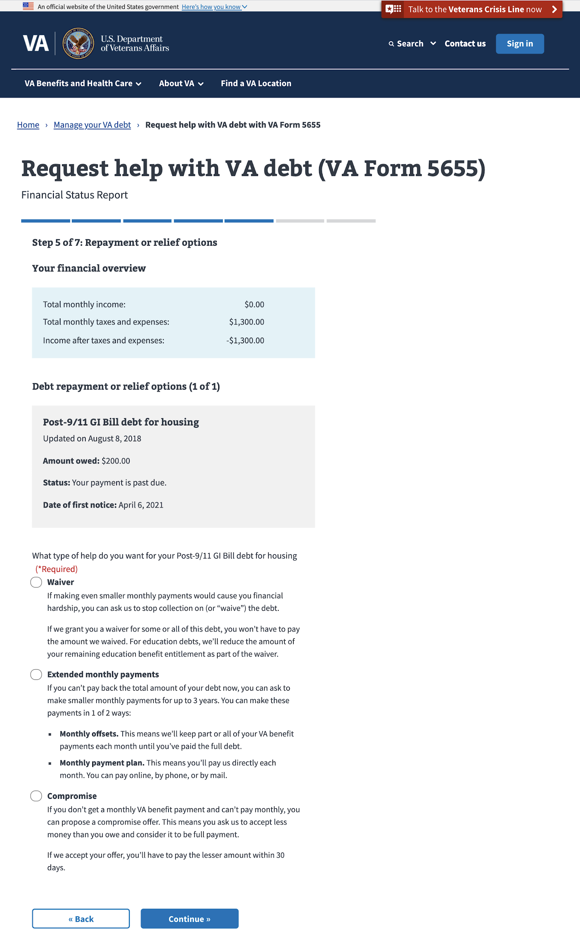
FSR MVP Usability
Do Veterans understand each resolution option and the impact each one has on the form's processing order?
Most understood the resolution types available, however:
3 participants were confused why they were being asked to select resolutions multiple times
“Uhh ok… in other words, they didn’t like my response! Is that what happened? I would probably try to find the reason that it went back to this screen.”

Slide 31
FSR MVP Usability
Do Veterans understand each resolution option and the impact each one has on the form's processing order?
Most understood the resolution types available, however:
Multiple participants wanted to select waiver as their first option and wondered what the next step would be if the waiver was denied; there was interest in selecting multiple resolution options
“If I request a waiver first, my question is… ok if you don’t allow a waiver, then uh… do we get to negotiate one of my other two options?”

Slide 32
FSR MVP Usability
What do Veterans expect to do if they need to submit the form with revisions?
Veterans expressed multiple ways they’d expect to revise their submission, with most wanting to make edits using a digital format
4 wanted to be able to go back and directly edit their form submission in a more streamlined way so they didn’t have to fill the entire form out again
3 wanted to be able to submit a followup statement/addendum
“Going through everything, multiple copies, would rather be short, sweet, and to the point. Say there's a change to the income and describe the change to the income and then a submit button.”
1 participant was worried that resubmitting the form with changes would put her at “the bottom of the list”

Slide 33
FSR MVP Usability
Are Veterans able to easily use the new list loop component?
Overwhelmingly no; Veterans were able to input their data and complete the form, but they consistently misunderstood the capabilities of the list loop pattern
Most participants struggled with the type ahead component within the list loop cards
Most participants did not realize that they would see suggested options once they started typing. This led to some participants hesitating for extended periods while thinking of options
Nearly all participants thought they had to choose one of the suggestions given; they did not realize they could enter their own option into the field
Several participants would type in a few letters and then browse the suggestions in the dropdown

Slide 34
FSR MVP Usability
Are Veterans able to easily use the new list loop component?
Overwhelmingly no; Veterans were able to input their data and complete the form, but they consistently misunderstood the capabilities of the list loop pattern
One participant typed single letters individually to see if he “missed anything”
A few participants ignored the save button on the list loop cards, sometimes having several open and unsaved at once before continuing
Several participants noted a few areas where entering their information in separately was labor intensive (e.g. individual credit cards and utilities)

Slide 35
FSR MVP Usability
What do Veterans expect to do after they've submitted their request?
A majority of Veterans expect a confirmation or notification, including:
A follow-up timeline and number (5)
Email notification (4)
An application/reference number (3)
A copy of the submission (4)
Full document download (3)
Screenshots of the form (1)
When asked what they’d do next, we heard things like:
"Pray", "Go drink a beer", "Go lay down", "Congratulations, you lived!"

Slide 36
FSR MVP Usability
What communications do Veterans expect to receive about their request?
A majority of Veterans expected to receive communication about their request via email
6 participants mentioned receiving email communications after submitting the form
Many participants mentioned follow-up communication from VA so they had peace of mind that their request was being processed
“I want them to be managing their caseload so that they have taken some kind of action in a period of time… and let me know that I’m in the queue for something and give me an opportunity to follow up on that. I don’t want to fall into a black hole.”
Desired email correspondence included updates about the debt, form submission confirmation, and processing information

Slide 37
Recommendations

Slide 38
FSR MVP Usability
Short term:
Include ‘contractor’ as an Employment Type
Update the employment sections to allow multiple current positions
Provide some content / guidance for current list loops:
Alleviate concerns around repossession of vehicles
Detail what should qualify as “other assets”
Encourage users to include as many expenses as are reasonable
Update the resolution selection screen to not loop through selected debts
Include a “Request number” or “Confirmation number” on the confirmation page
Update ‘Review’ screen to open cards on edit

Slide 39
FSR MVP Usability
Long term:
Rework all instances of list loops to be more accurately grouped and assistive
Consider providing a list of commonly added items and an ‘other’ option for items that are more specific to that Veteran’s financial situation
Incorporate form status notifications into the Debt Portal’s notification plan
Reevaluate the concept of preferred resolutions (e.g. “I want a waiver, if not, a compromise.”
Reinvestigation of summary page with the addition of medical copayment debts
Reimagine scaffolding of Review page with the new one-question-per-page concept [broader initiative]
Break out Credit Cards from “Installment contracts and other debts” section

